Slide 1
Home Automation
Brian Curtis, Awa Ka, Dean Nelson, Colin Redmond

Slide 2
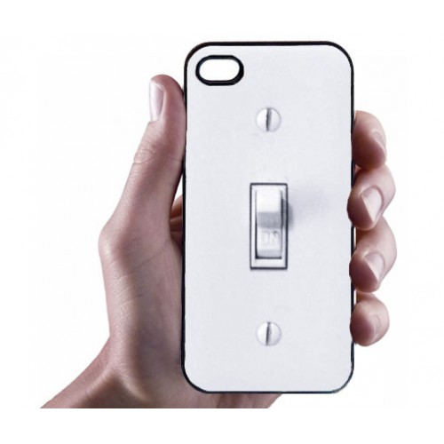
Light Switch With Android App
Switch light on and off mainly using the Android application, Bluetooth and Arduino Uno

Slide 3
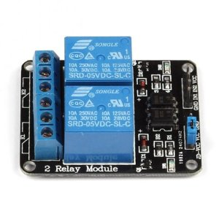
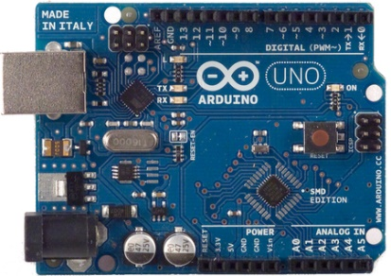
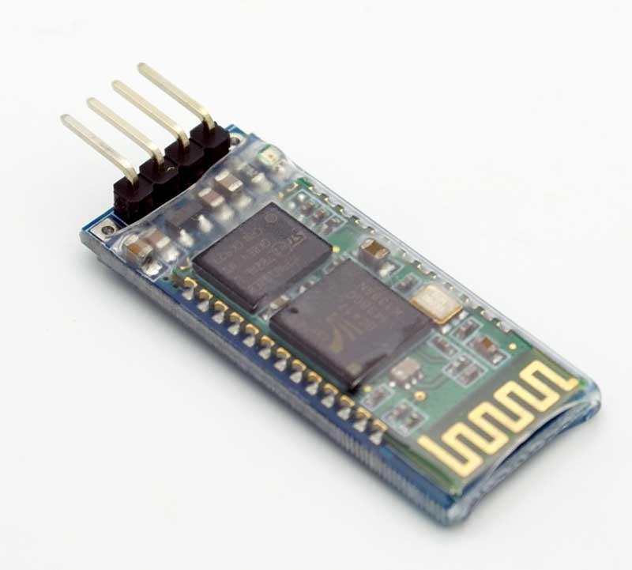
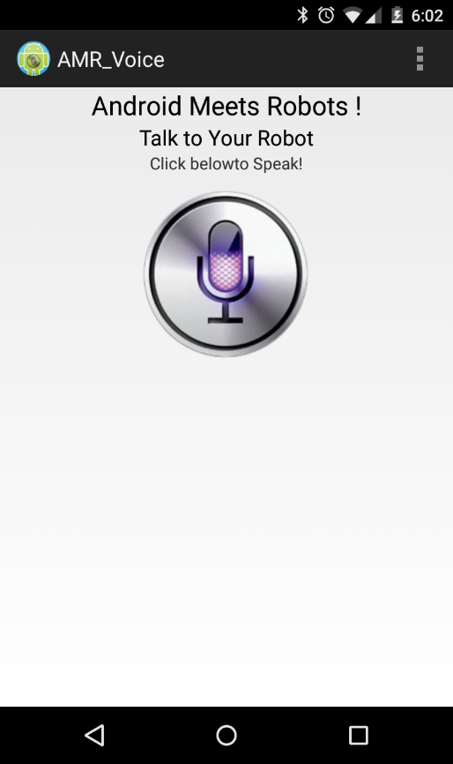
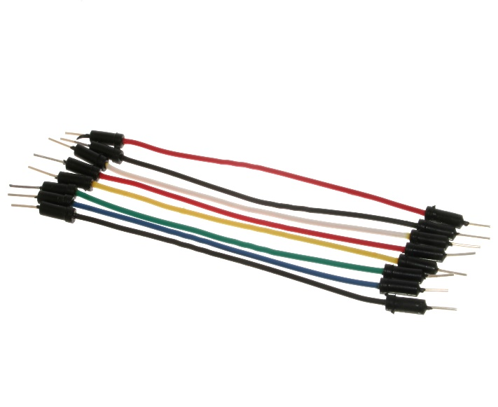
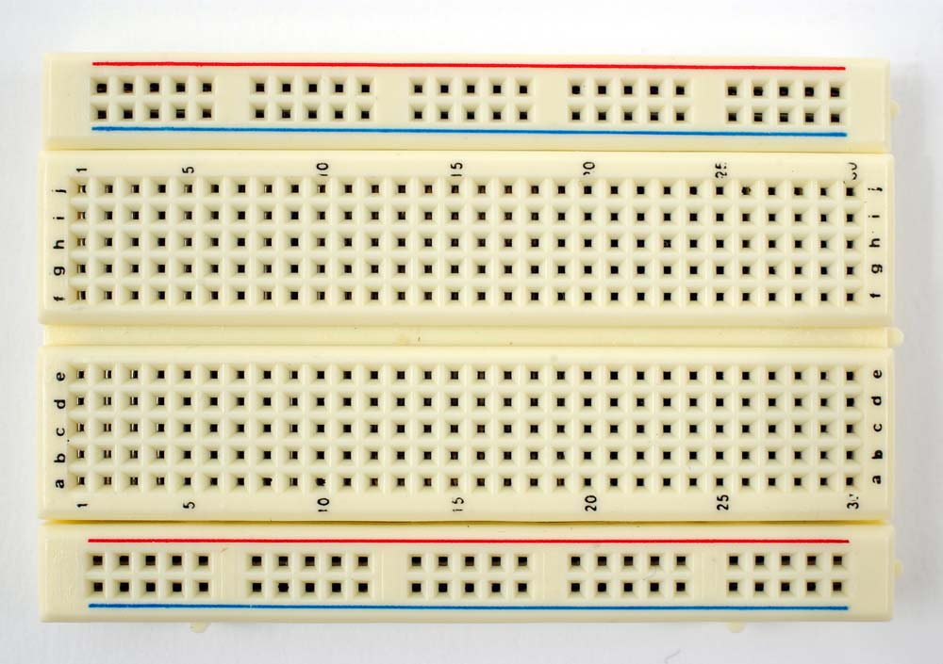
Parts Needed

Slide 4
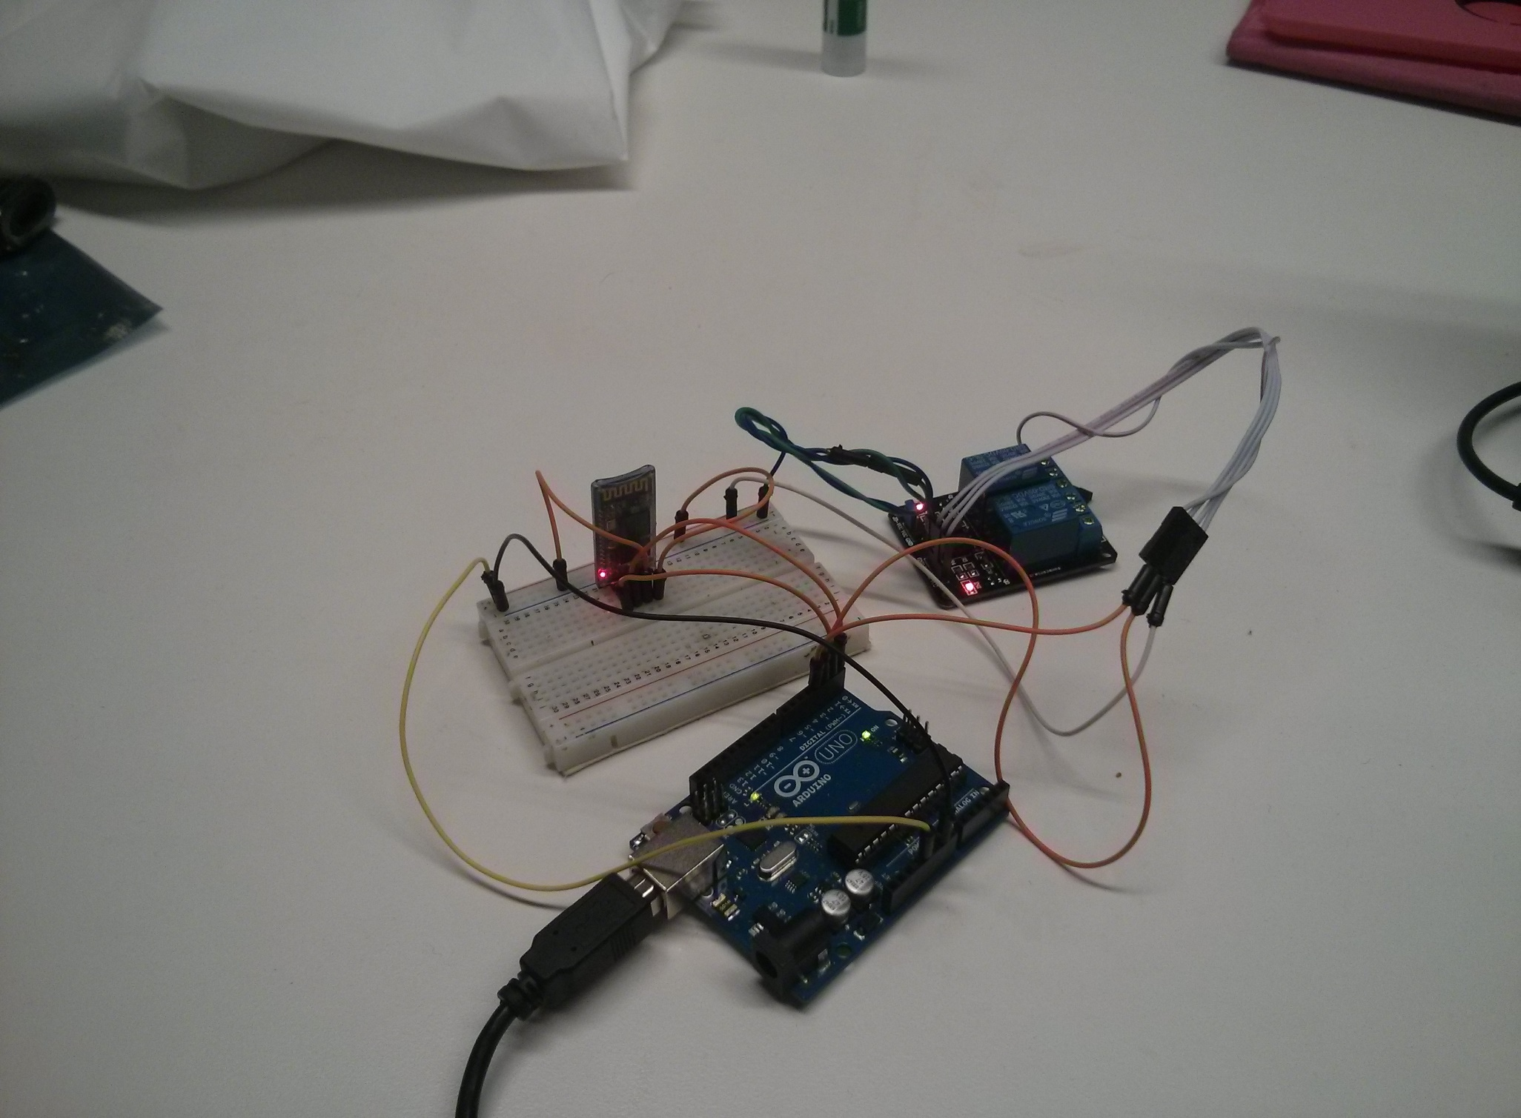

Slide 5
Laundry Machine Completion Sensor
Part worked on by: Brian Curtis

Slide 6
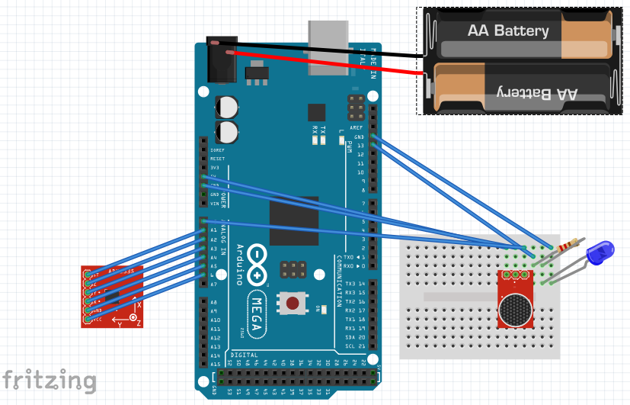

Slide 7
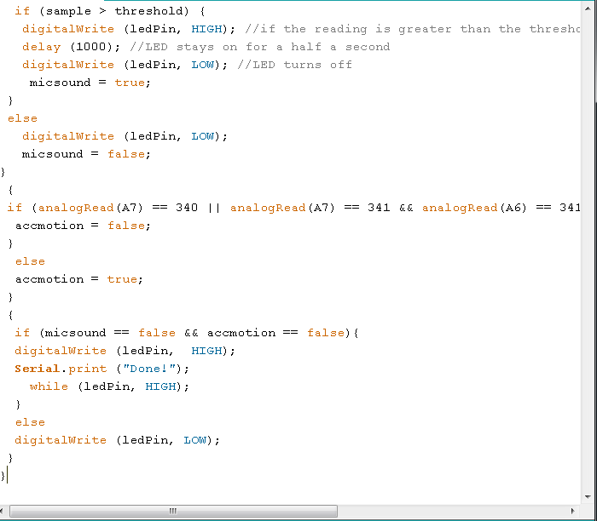
Code for microphone TRUE or FALSE
Code for accelerometer TRUE or FALSE
accelerometer “motionless” values
End phase if washing machine is determined finished.

